Slide 1
Activation Synthesis Theory of Dreaming
MASTER CLASS

Slide 2

The activation-synthesis theory is a neurobiological explanation of why we dream.

Slide 3
An overview
Harvard psychiatrists J. Allan Hobson and Robert McCarley first proposed their theory in 1977, suggesting that dreaming results from the brain's attempt to make sense of neural activity that takes place during sleep.
Even when you are sleeping, your brain is quite active. Hobson and McCarley suggested that during sleep, activity in some of the lower levels of the brain that are primarily responsible for basic biological processes are then interpreted by the parts of the brain responsible for higher-order functions such as thinking and processing information.

Slide 4
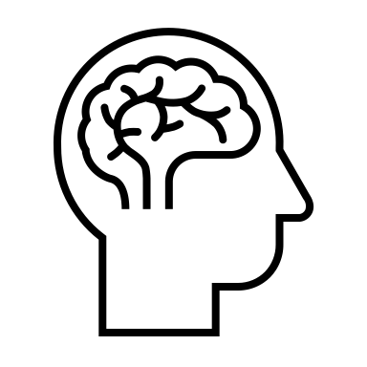
Explain visually and verbally how different parts of the brain function.
What did the theory suggest?
Dreams occur when the mind tries to make sense (synthesis) of the brain activity happening during sleep (activation).
They believe that
dreams have
no real meaning.

Slide 5
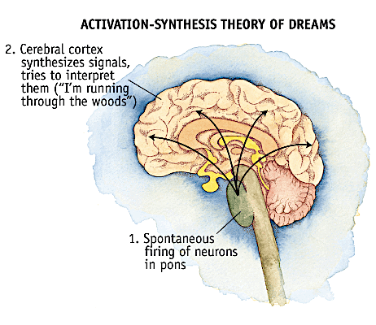
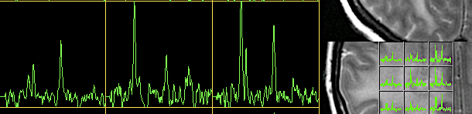
The neuropsychology in the theory
Explain visually and verbally how different parts of the brain function.
Just before & during REM sleep:
Powerful electrical signals pass through the brain like a wave – appear like sudden spikes.
Signals come from pons in the brainstem & from the neurons that move the eyes – activates the limbic system & travels to the occipital lobe.
Spikes – send surge of stimulation through the brain that activates the cerebral cortex & the higher brain tries to give meaning to what is happening.

Slide 6
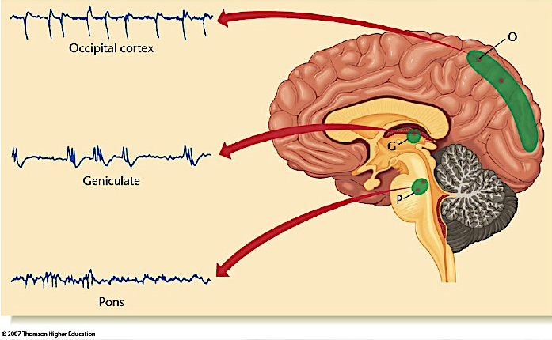
Explain visually and verbally how different parts of the brain function.

Slide 7
The connection to dreaming
Explain visually and verbally how different parts of the brain function.
The effort to give these sudden signals meaning is what leads us to dream.
The brain draws upon its memories to provide synthesis (a meaning that makes sense).
But because different areas of the brain are activated this can be quite strange.
EXAMPLE
The spikes might be similar to those produced whilst running – when sleeping a person might synthesise those signals & dream of running.
As pons continue to fire, the higher brain has to keep making sense of them, which is why dreams can shift so quickly.

Slide 8
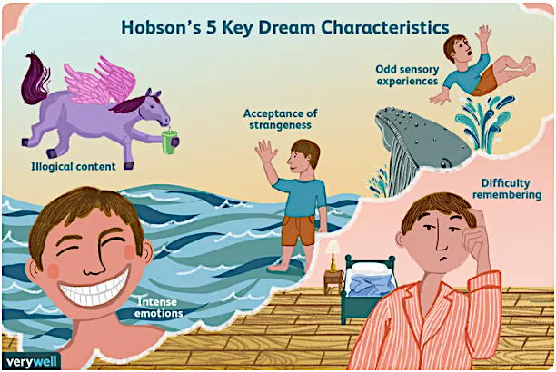
Explain visually and verbally how different parts of the brain function.
Credit: https://www.verywellmind.com/what-is-the-activation-synthesis-model-of-dreaming-2794812

Slide 9
In summary
Explain visually and verbally how different parts of the brain function.
High levels of activity in the brainstem are necessary for dreaming to take place.
Activation in these areas of the brain results in REM sleep and dreaming and that all dreaming takes place during REM sleep.
The forebrain attempts to place meaning on the random signals created from the activation of the brainstem, resulting in coherent dreams.

Slide 11
CRITICISMS
The theory is too reductionist
+ Dreams are complex & packed full of meaning – cannot reduce them down to simple neuronal processes.
Patients with damage to the brainstem do not stop dreaming – contradicts the theory.
+ Even with usual signals not been sent, they still dream.
The theory states that dreaming only occurs in REM sleep but dreams occur in non-REM stages of sleep.
+ Brain activity is reduced in other stages of sleep, there is evidence of dreaming even if it isn’t as vivid.

Slide 12
CHALLENGE HOMEWORK TASK – sleep journal
Over the next week, you are to record your dreams in a sleep journal.
Each day when you wake up take 5-10minutes to quickly write down what you dreamed about.
If you can’t remember anything, note this down, but across 7 days you should be able to describe at least 1-2 dreams.

Slide 13
CHALLENGE HOMEWORK TASK – sleep journal analysis
Use the bizarreness coding scale devised by Hobson et al. (1987) and have a go at coding someone else’s dreams in groups of four (each student codes another three students dreams).
Now compare your analysis to check for inter-rater reliability as in the original study which had three judges.
What problems did you have in reporting dreams/fantasies?
How could this influence results?
Why could this have been a problem in Williams’ research?
Recap social desirability bias- why was social desirability a problem in the research?

Slide 14


The Reductionism VS Holism Debate
Make supported judgments on debates in psychology.
Reductionism is here you break down a behaviour into its constituent parts and analyse the relative contribution that factor makes.
This approach to investigating behaviour assumes that parsimony, the scientific principle, should be used and that all behaviour should be explained using the simplest possible explanation.
Parsimony = choose the simplest scientific explanation that fits the evidence.
Holism is where you assume that the ‘whole is greater than the sum of its parts’ and that in order to understand behaviour you should consider how different factors at each level contribute to behaviour, rather than trying to reduce these further.
This position in the debate suggests that behaviour is too complex to be broken down.

Slide 15
The Reductionism VS Holism Debate
Make supported judgments on debates in psychology.
Weaknesses of holism: If we assume everyone is different and unique it is very hard to test behaviour and make predictions.
Strengths of holism: Recognises the importance of seeing people as individuals and that one approach cannot fully explain human behaviour.
Weaknesses of reductionism: It may ignore important factors that contribute to how we think and behave.
Strengths of reductionism: Looking at specific parts of behaviour allows us to test them scientifically and make predictions.

Slide 16
For example…
Make supported judgments on debates in psychology.
A person might go to their doctor with symptoms of depression. The doctor might prescribe anti-depressant drugs to try to control the activity of neurotransmitters such as serotonin in the brain. This would be a reductionist approach as the patient is seen as a biological organism with an organic illness that is caused by an imbalance of serotonin (i.e. the explanation for depression is reduced down to the level of biological explanations.
A holistic approach would involve trying to find out more about the person and the background to the problem and would include physical health in general; work /social/family issues before deciding on a course of therapy.

Slide 17
Reductionism versus Holism
Synoptic Task
Apply the reductionism debate to other theories we have looked at so far. Rank them in terms of a reductionism/holism continuum.
(2) Use your knowledge and understanding from across the psychology course to explain how far you agree with the following viewpoint:
“Often the simplest explanation is the best.”
In your answer you should refer to the activation synthesis theory of dreaming and at least one different area of psychology you have studied. [13]
Reductionism Holism

